Slide 1
PREDICTIVE MODEL ON BRITISH AIWAYS BOOKING RECORDS
By: Abdulmalikul-mulk Abdulrahman

Slide 2
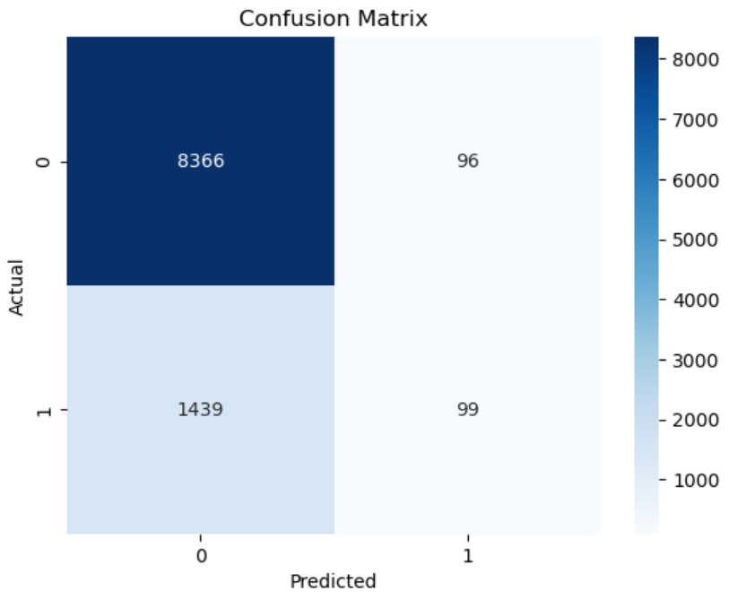
Summary of Booking Prediction Model.
 | Precision | Recall | F1-Score
0 | 0.85 | 0.99 | 0.92
1 | 0.51 | 0.06 | 0.11
0 → Complete booking
1 → Incomplete booking
The table above gives a breakdown of the accuracy scores.
The model is able to predict the customers that won’t complete their boking with an 85% precision and those likely to complete their booking with 51% precision.
The dataset provided contain record of customers that completed their booking 15% and those that didn’t 85%.
This much difference in class constitutes an imbalance and may likely affect the prediction accuracy.
As a result of the imbalance in the classes i.e Complete and Incomplete bookings, the model while largely accurate-is more likely to accurately predict that a customer won’t complete their booking, with an accuracy of 85%.

